Slide 1
American sign language RECOGNITIOn for alphabets Using LSTM
Sundar.B
CB.EN.P2AID20041
M.tech Artificial Intelligence Engineering, 4 sem
Department Of Computer Science And Engineering
Guided by
Bagyammal.t
Assistant Professor
Department Of Computer Science And Engineering

Slide 2
Problem StatemeNt
Propose an algorithm using Long Short Term Memory (LSTM) to perform American sign language recognition for alphabets (A-Z).

Slide 3
Motivation
Sign Language is widely used by 250,000 to 500,000 people around the world [6].
It is very difficult for people to understand sign language if they are not familiar with it.
The aim is to help the people to recognize alphabets using hand gestures.

Slide 4
Literature survey
S.no | Reference Paper Author and Year of publication | Reference Paper Title | Inference From Paper
1. | Abdulwahab A.Abdulhussein, Firas A.Raheem 2020 | Hand Gesture Recognition of Static Letters American Sign Language (ASL) Using Deep Learning | It uses Deep Learning to recognize the ASL gestures. It converts the images to grayscale and uses edge detection and deep learning to detect the ASL gestures.
2. | Teak-Wei Chong and Boon-Giin Lee 2018 | American Sign Language Recognition Using Leap Motion Controller with Machine Learning Approach | This paper uses Leap motion controller and gets the input from it and processes the gestures and recognizes the hand gestures.
3. | Matteo Rinalduzzi 1 , Alessio De Angelis, 2021 | Gesture Recognition of Sign Language Alphabet Using a Magnetic Positioning System | This paper uses gloves and has several hand sensors on hand to recognize different hand gestures.
4. | Sourav Bhowmick, Sushant Kumar and Anurag Kumar . 2015 | Hand Gesture Recognition of English Alphabets using Artificial Neural Network | This paper helps us recognize ASL gestures using Artificial Neural Network and also shows how a combination of two words work

Slide 5
Literature survey
S.no | Reference Paper Author and Year of publication | Reference Paper Title | Inference From Paper
5. | Rajesh George Rajan, Dr.M.Judith Leo 2020 | American Sign Language Alphabets Recognition using Hand Crafted and Deep Learning Features | It uses Deep Learning to recognize the ASL gestures. It uses public dataset and performs ML algorithms on it and gives us a classified report.
6. | Murat Taskiran, Mehmet Killioglu, and Nihan Kahraman 2018 | A Real-Time System For Recognition Of American Sign Language By Using Deep Learning | This paper uses shows us how different algorithms have different effects on the result of the gestures recognized.
7. | Prangon Das , Tanvir Ahmed , Md. Firoj Ali 2020 | Static Hand Gesture Recognition for American Sign Language using Deep Convolutional Neural Network | This paper uses Deep learning to recognize the hand gestures. This also explains models like Alexnet, RaodeepCNN etc.
8. | Ariya Thongtawee , Onamon Pinsanoh, Yuttana Kitjaidure in 2018 | A Novel Feature Extraction for American Sign Language Recognition Using Webcam | It divides the frame into left and right sides. It recognizes the edges on the each sides and detects the sign

Slide 6
Literature Survey
S.no | Reference Paper Author and Year of publication | Reference Paper Title | Inference From Paper
9. | Chinmaya R. Naguri and Razvan C. Bunescu in 2017 | Recognition of Dynamic Hand Gestures from 3D Motion Data using LSTM and CNN architectures | this paper is that it uses Leap motion to get the data and it uses leap motion to detect the hand gestures.
10. | Murat Taskiran, Mehmet Killioglu, and Nihan Kahraman 2018 | A Real-Time System For Recognition Of American Sign Language By Using Deep Learning | This paper uses shows us how different algorithms have different effects on the result of the gestures recognized.

Slide 7
Dataset
The dataset required for the experimental study of the proposed algorithm has been created using mediapipe open source library.
The mediapipe hand tracking library has around 21 key features in hand and it is used to generate the dataset.
The generated dataset contains all the 26 alphabets with hand gestures.
It captures the hand gestures for 30 frames.
The dataset has 30 different permutations for each alphabet.
The same dataset is collected from four different humans.
2 male
1 female
1 kid
As a total the dataset contains 93,600 values.
The dataset has different parameters that are time, values(x,y,z) of hand joints.
The dataset is divided into 90% for Training and 10% for Testing.

Slide 8
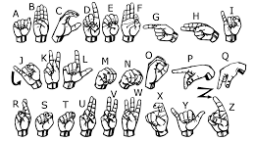
American Alphabet hand gestures

Slide 9

Mediapipe- Open source Library
Mediapipe is an opensource , high fidelity and finger tracking solution.
Mediapipe uses Palm detection model to get the hand bounding box.
A hand landmark detection over the palm detector and returns high-fidelity 3D hand keypoints.
It returns the accurately cropped image of the hand.
From the image you can find the 21 different key points that can be tracked by mediapipe.

Slide 10
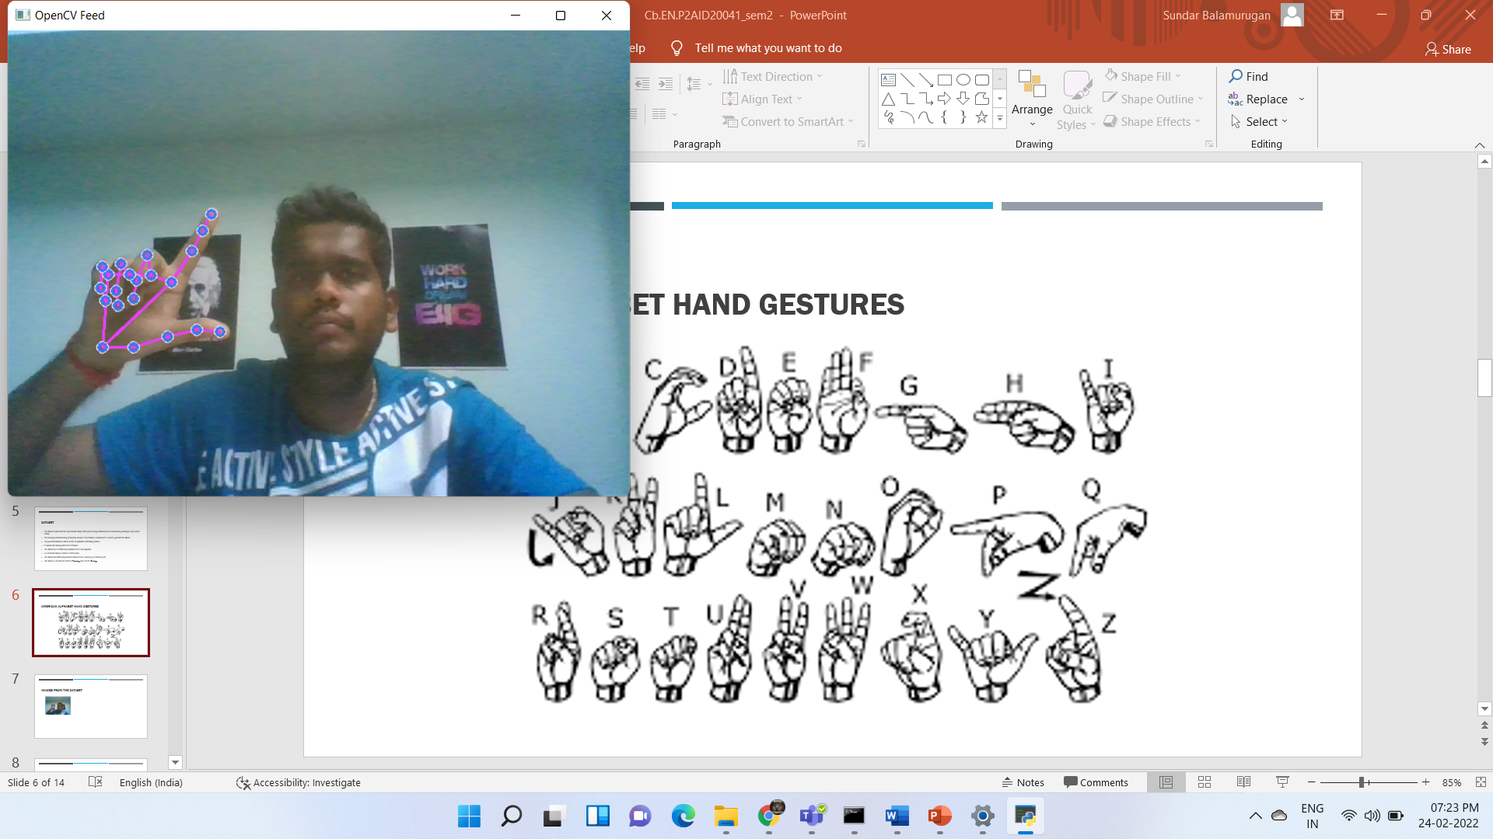
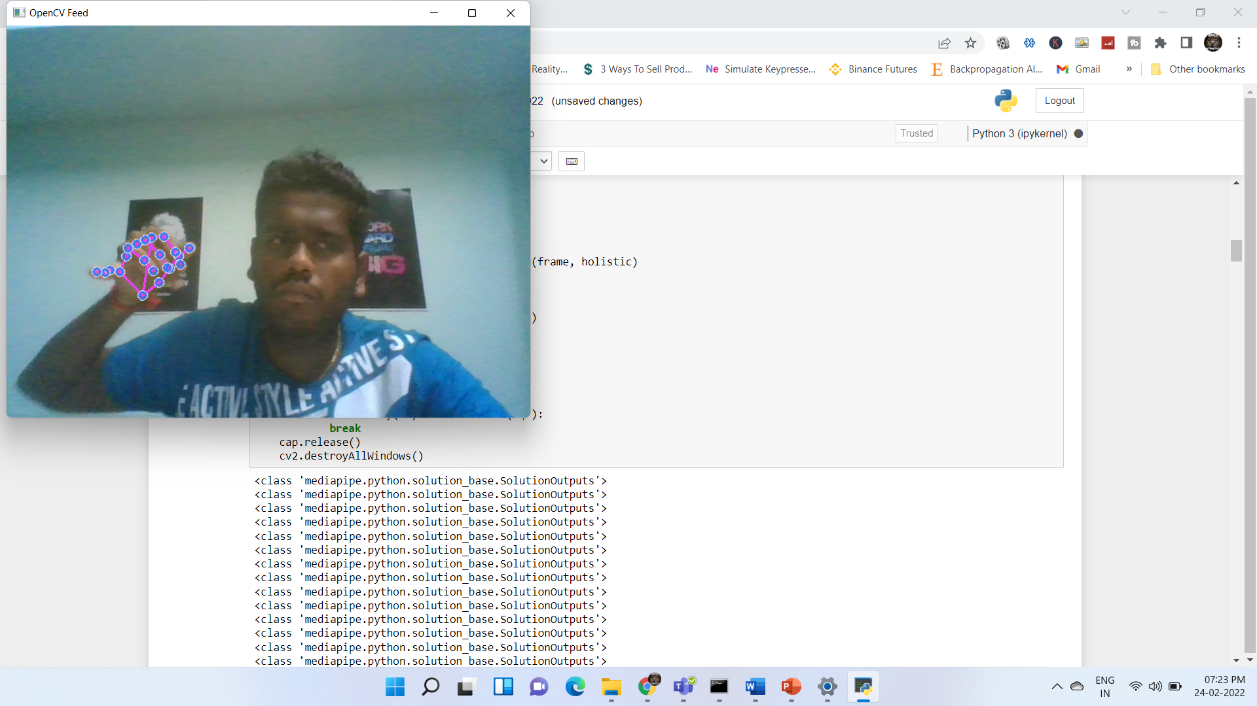
Images During Capturing the Dataset Preperation

Slide 11
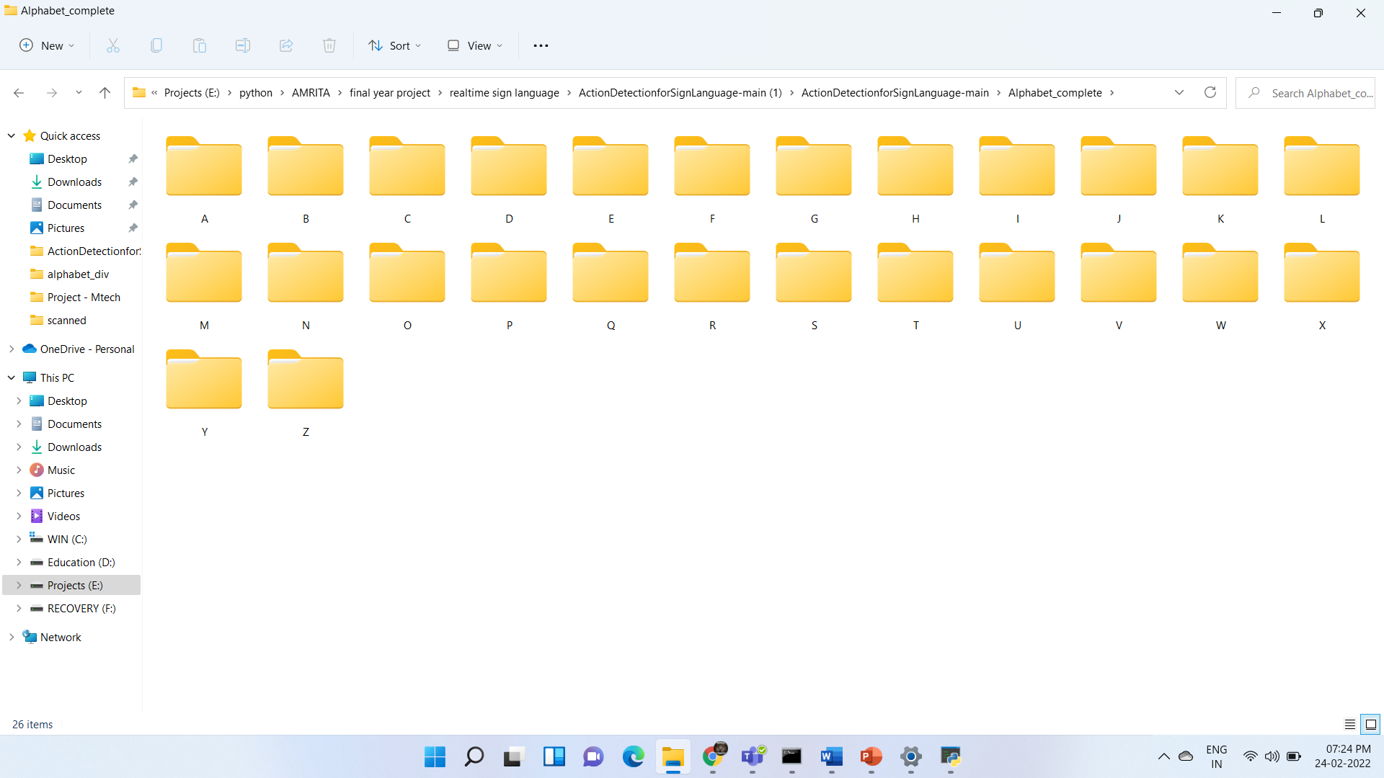
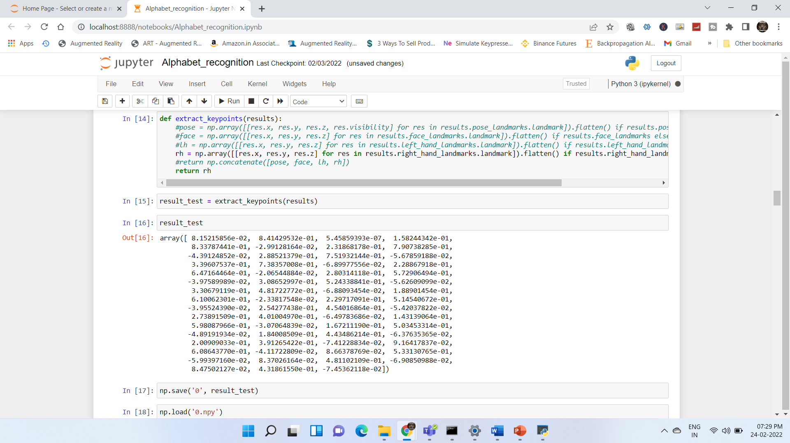
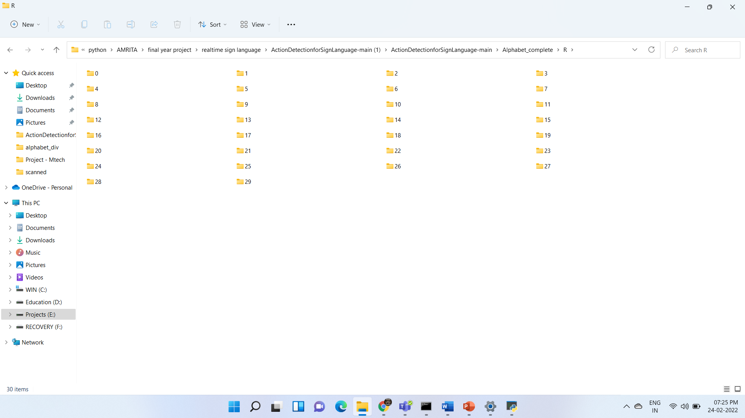
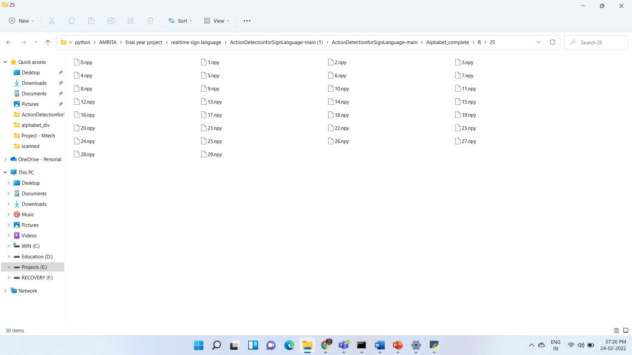
Images from the dataset

Slide 12
Software and Hardware requirements
Software
Hardware
Python 3.X
Mediapipe
Tesorflow
Keras
CPU
Camera
GPU (optional)

Slide 13
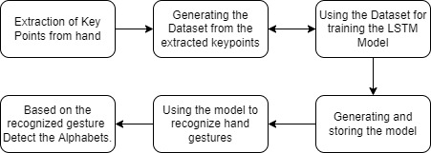
Architecture

Slide 14
Proposed system using lstm
All the 26 alphabet gestures are collected one after the other and are pre processed stored .
The dataset collected is then passed onto the LSTM model.
The LSTM model will have all the 26 alphabet classes for each of the alphabets.
The algorithm is made to run on 2000 epochs until the accuracy become 1 and training loss goes to nearly 0.
The algorithm runs and generates the model which is stored for future use.
The model can now be used for tracking the live hand gestures and further operations.
The system uses Rectified Linear Activation (Relu) as it would output the positive directly otherwise give zero.
The system uses Adam Optimizer Technique . Adam would adapt a learning rate for each network.

Slide 15
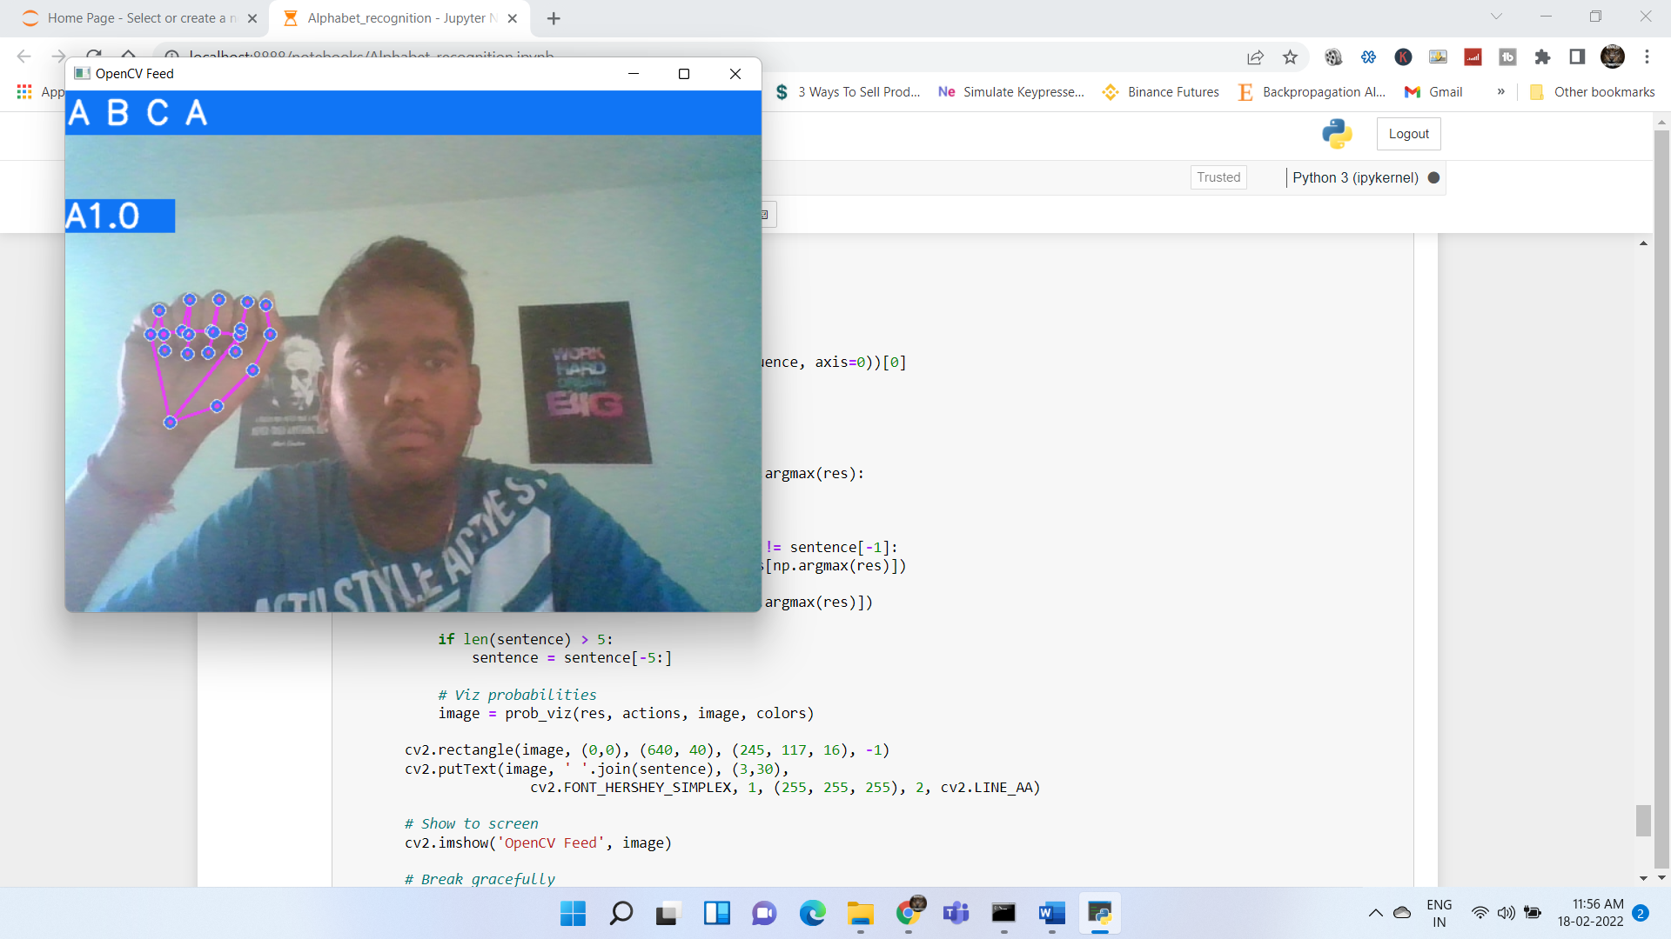
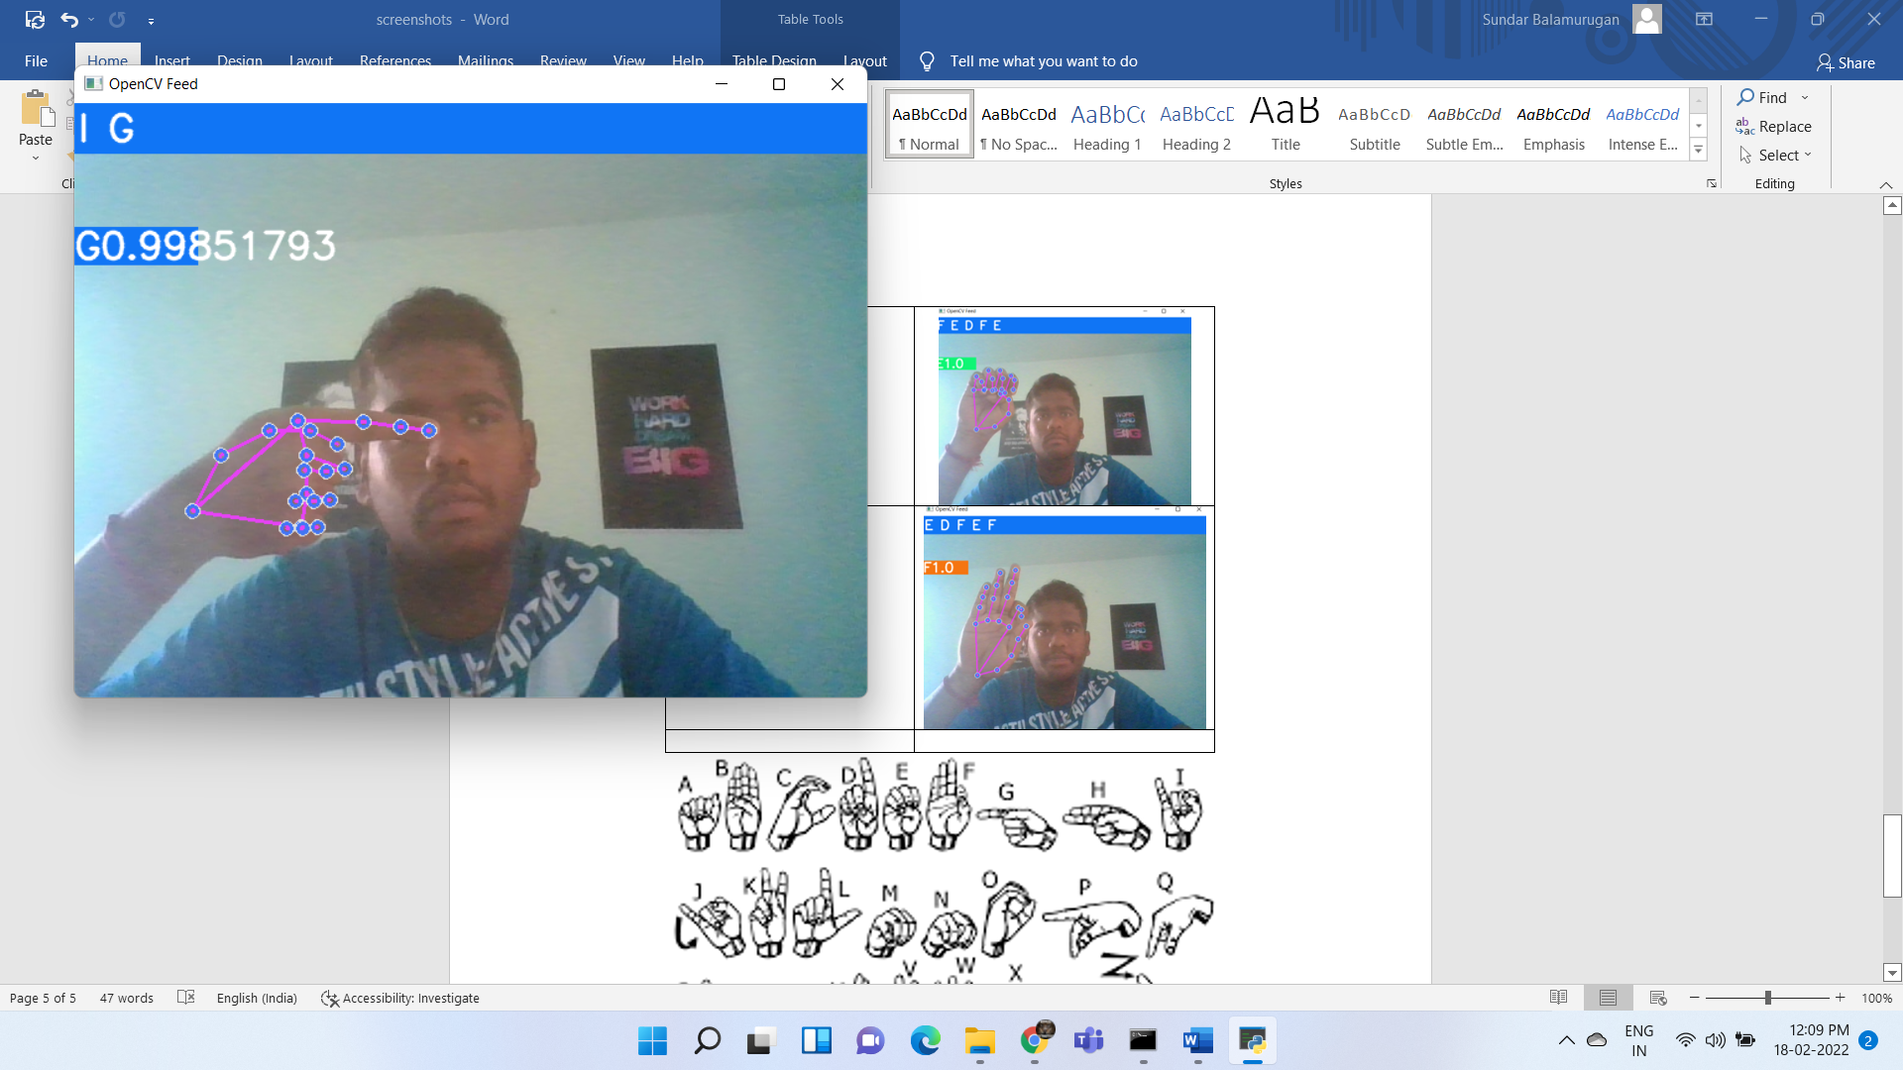
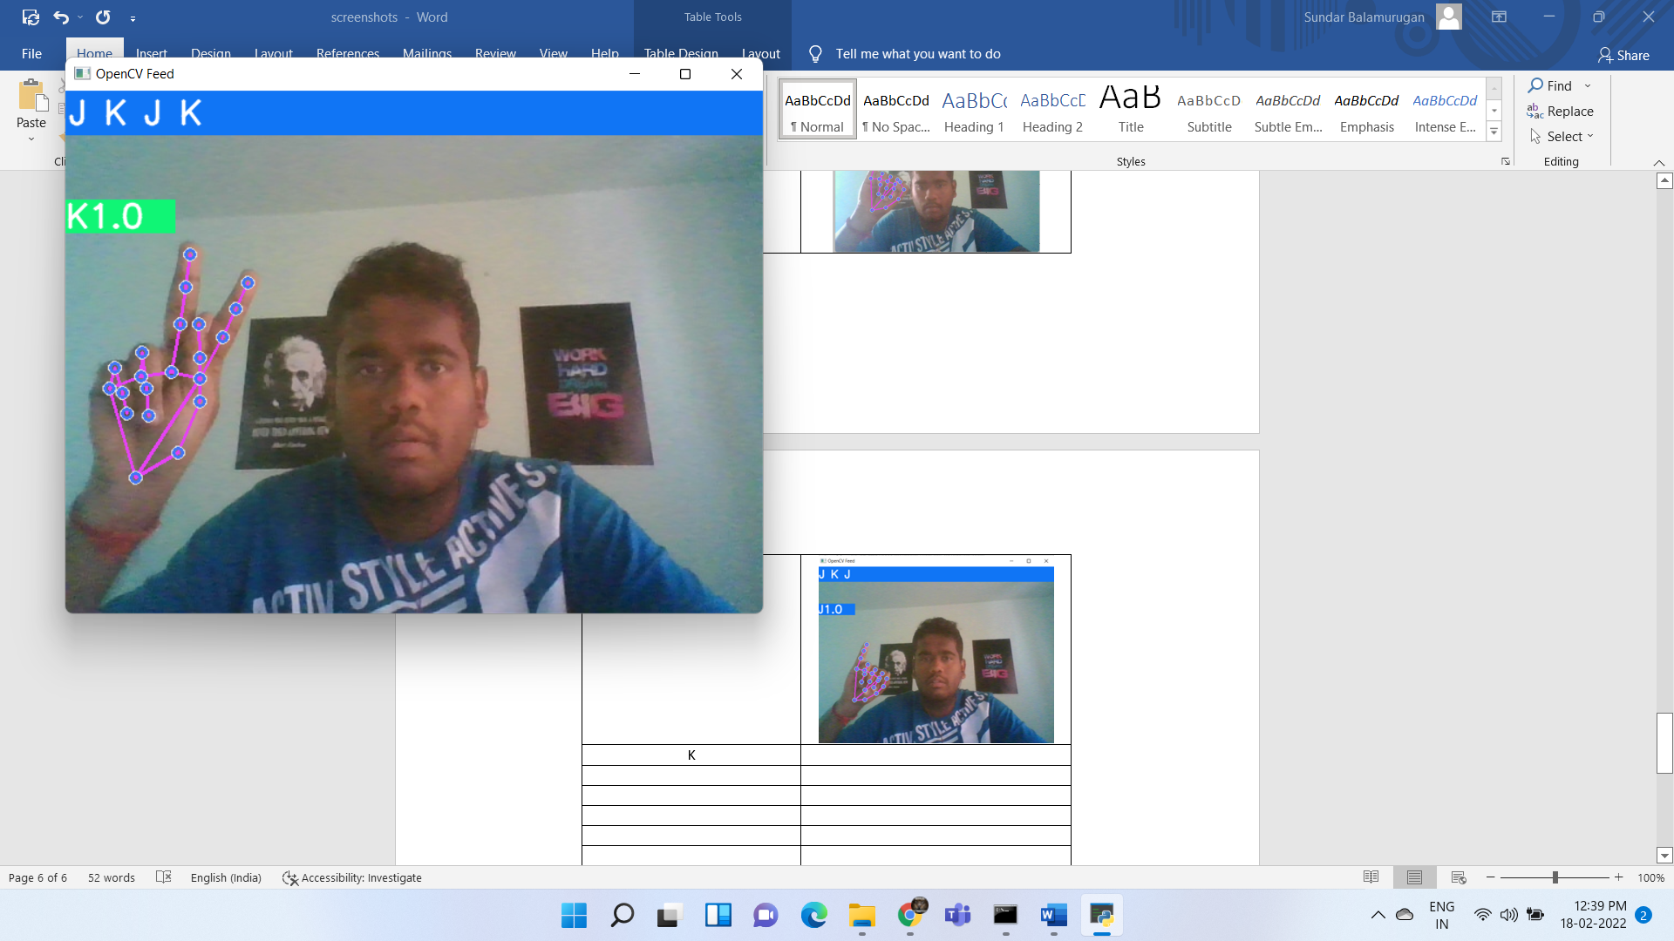
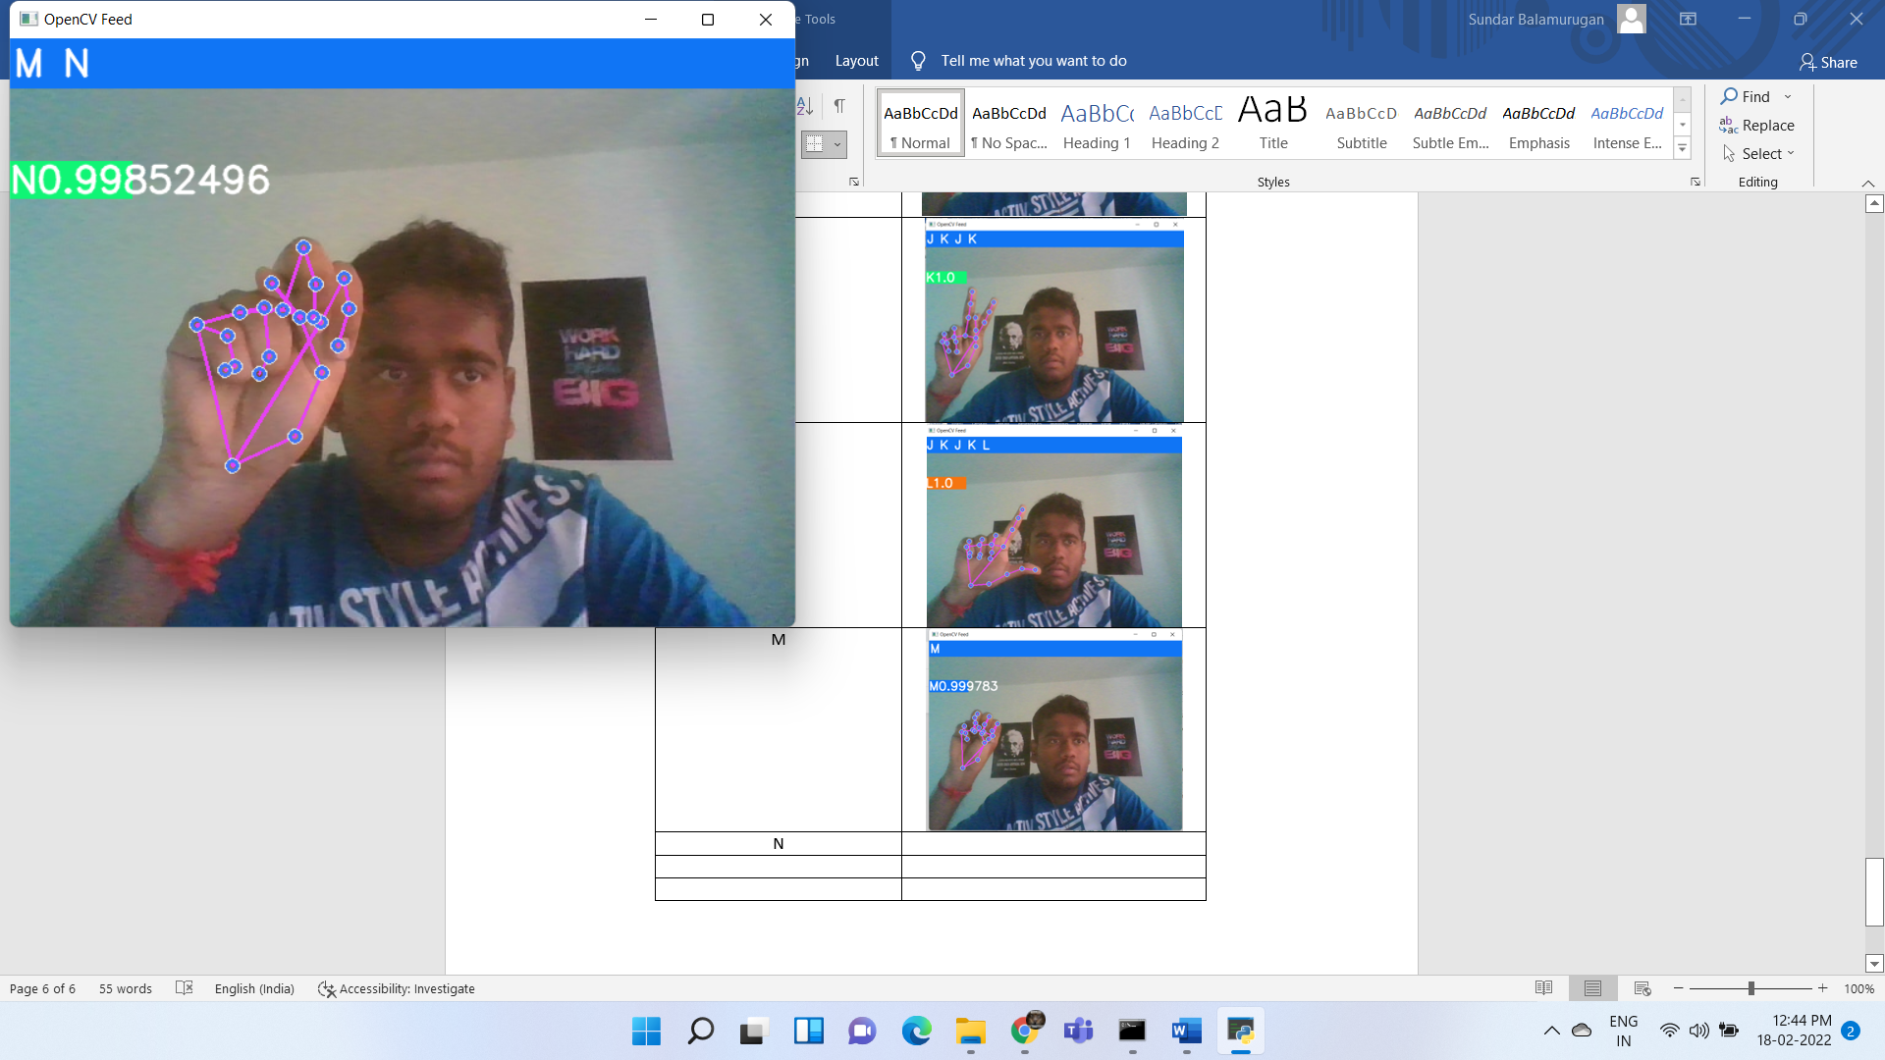
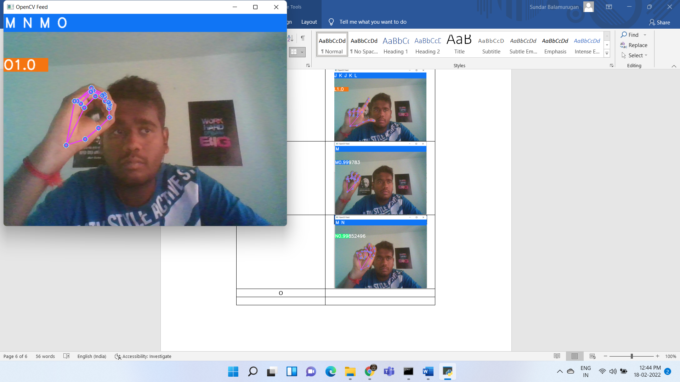
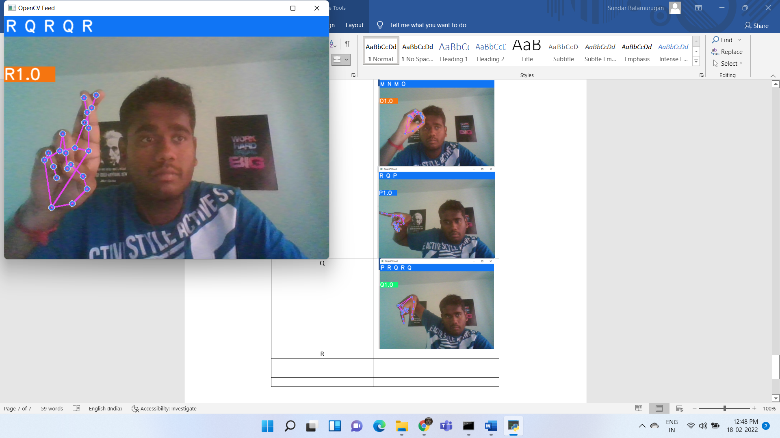
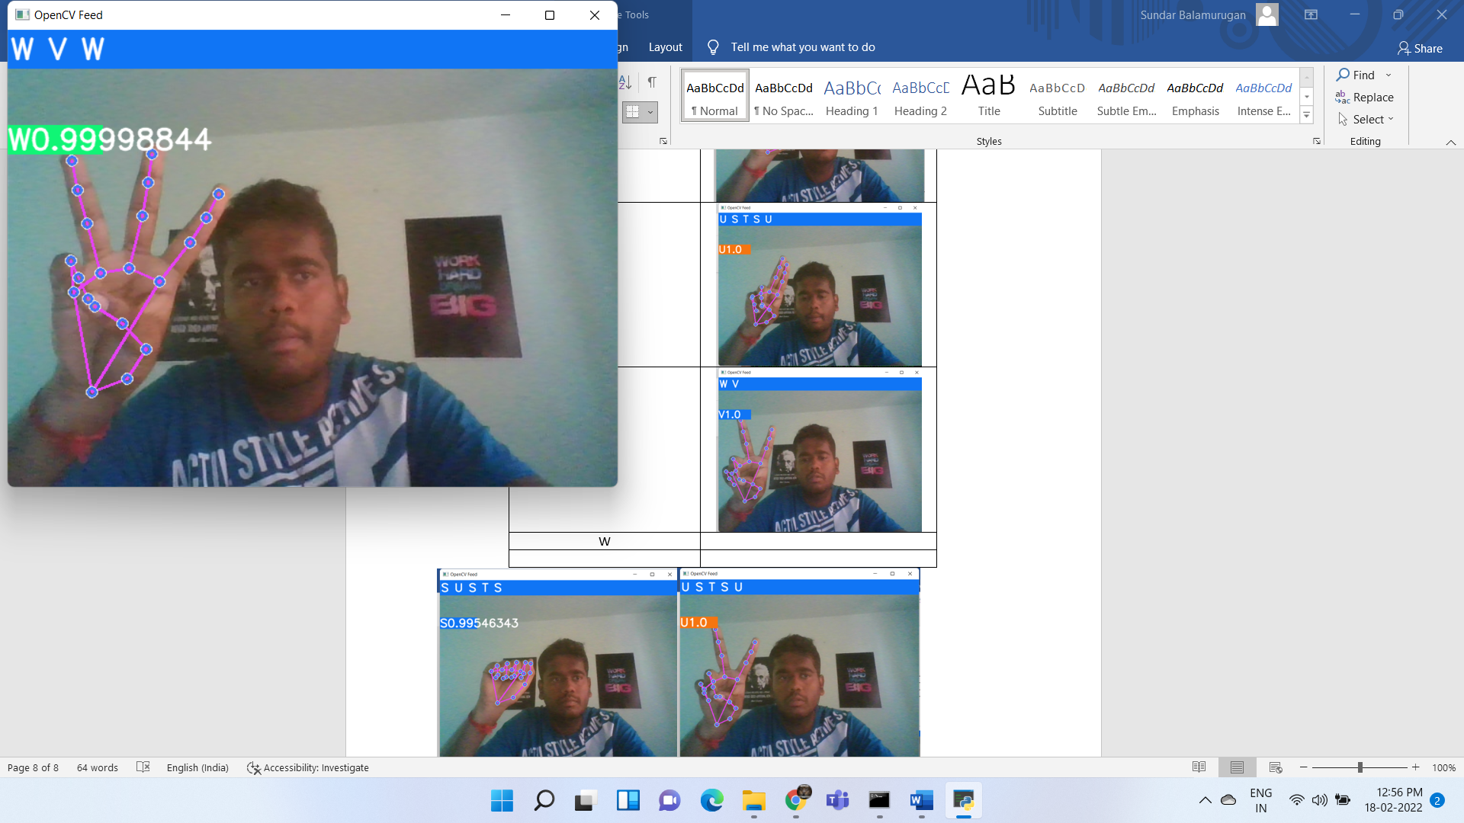
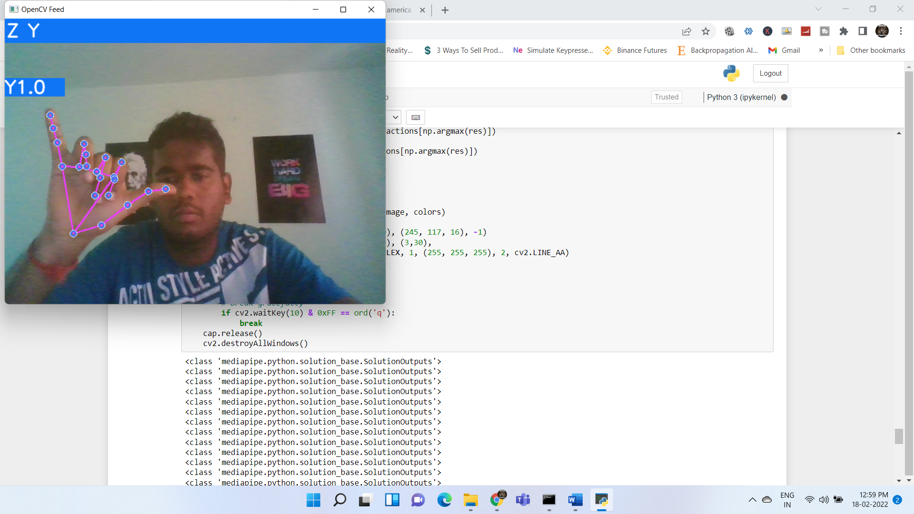
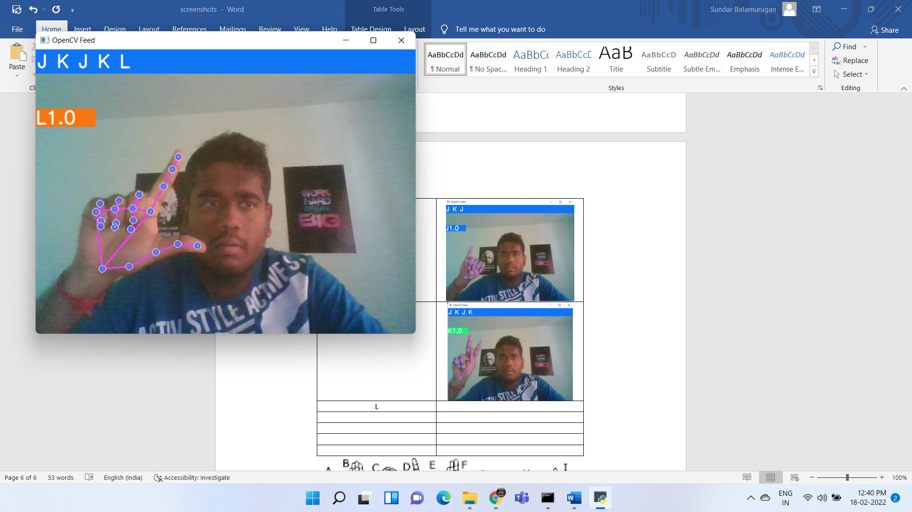
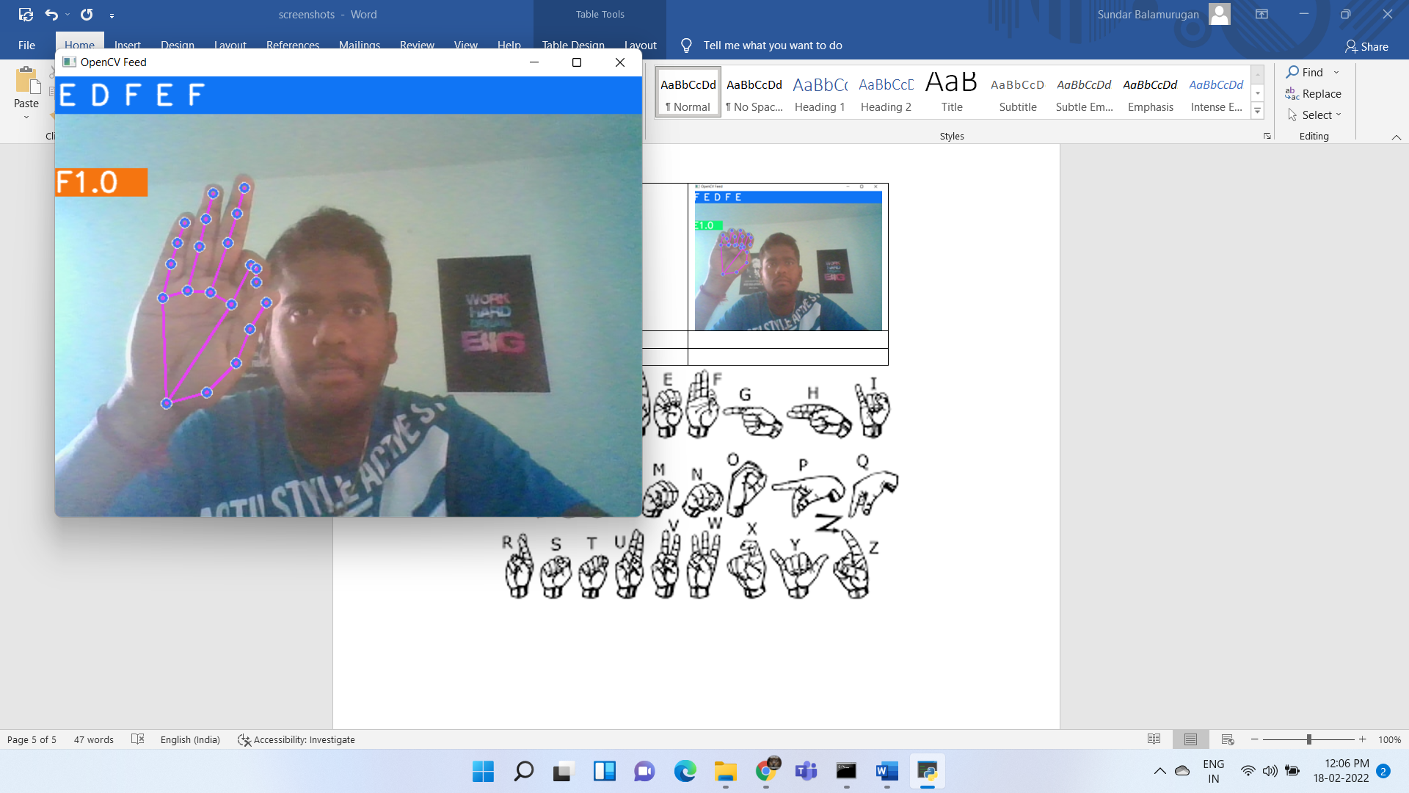
Results

Slide 16
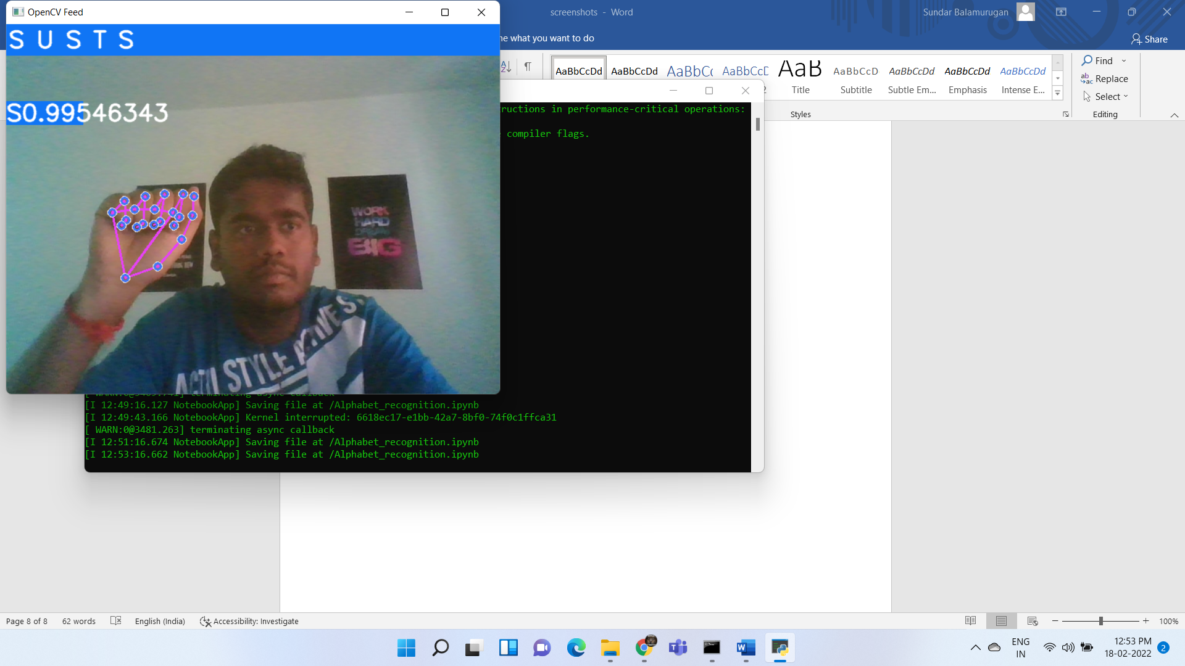
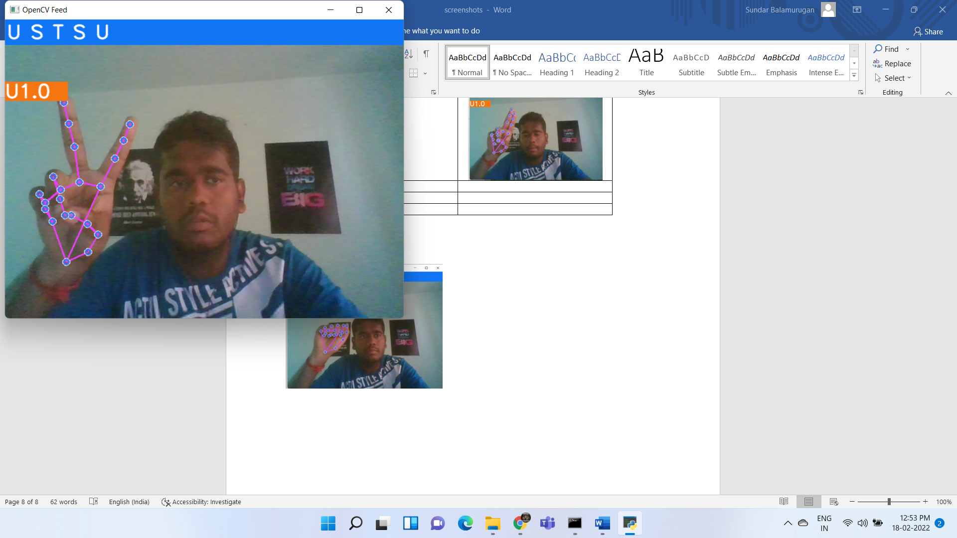
False recognitions

Slide 17
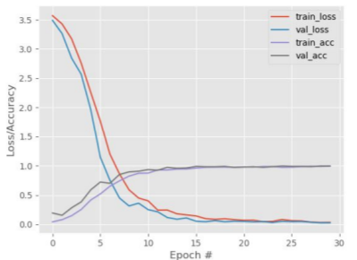
Graph of accuracy/Loss with epochs

Slide 18
Results - Confusion Matrix
 | A | B | C | D | E | F | G | H | I | J | K | L | M | N | O | P | Q | R | S | T | U | V | W | X | Y | Z
A | 13 | 0 | 0 | 0 | 0 | 0 | 0 | 0 | 0 | 0 | 0 | 0 | 0 | 0 | 0 | 0 | 0 | 0 | 0 | 0 | 0 | 0 | 0 | 0 | 0 | 0
B | 0 | 12 | 0 | 0 | 0 | 0 | 0 | 0 | 0 | 0 | 0 | 0 | 0 | 0 | 0 | 0 | 0 | 0 | 0 | 0 | 0 | 0 | 0 | 0 | 0 | 0
C | 0 | 0 | 13 | 0 | 0 | 0 | 0 | 0 | 0 | 0 | 0 | 0 | 0 | 0 | 0 | 0 | 0 | 0 | 0 | 0 | 0 | 0 | 0 | 0 | 0 | 0
D | 0 | 0 | 0 | 15 | 0 | 0 | 0 | 0 | 0 | 0 | 0 | 0 | 0 | 0 | 0 | 0 | 0 | 0 | 0 | 0 | 0 | 0 | 0 | 0 | 0 | 0
E | 0 | 0 | 0 | 0 | 8 | 0 | 0 | 0 | 0 | 0 | 0 | 0 | 0 | 0 | 0 | 0 | 0 | 0 | 0 | 0 | 0 | 0 | 0 | 0 | 0 | 0
F | 0 | 0 | 0 | 0 | 0 | 12 | 0 | 0 | 0 | 0 | 0 | 0 | 0 | 0 | 0 | 0 | 0 | 0 | 0 | 0 | 0 | 0 | 0 | 0 | 0 | 0
G | 0 | 0 | 0 | 0 | 0 | 0 | 16 | 0 | 0 | 0 | 0 | 0 | 0 | 0 | 0 | 0 | 0 | 0 | 0 | 0 | 0 | 0 | 0 | 0 | 0 | 0
H | 0 | 0 | 0 | 0 | 0 | 0 | 0 | 9 | 0 | 0 | 0 | 0 | 0 | 0 | 0 | 0 | 0 | 0 | 0 | 0 | 0 | 0 | 0 | 0 | 0 | 0
I | 0 | 0 | 0 | 0 | 0 | 0 | 0 | 0 | 10 | 0 | 0 | 0 | 0 | 0 | 0 | 0 | 0 | 0 | 0 | 0 | 0 | 0 | 0 | 0 | 0 | 0
J | 0 | 0 | 0 | 0 | 0 | 0 | 0 | 0 | 0 | 11 | 0 | 0 | 0 | 0 | 0 | 0 | 0 | 0 | 0 | 0 | 0 | 0 | 0 | 0 | 0 | 0
K | 0 | 0 | 0 | 0 | 0 | 0 | 0 | 0 | 0 | 0 | 9 | 0 | 0 | 0 | 0 | 0 | 0 | 0 | 0 | 0 | 0 | 0 | 0 | 0 | 0 | 0
L | 0 | 0 | 0 | 0 | 0 | 0 | 0 | 0 | 0 | 0 | 0 | 15 | 0 | 0 | 0 | 0 | 0 | 0 | 0 | 0 | 0 | 0 | 0 | 0 | 0 | 0
M | 0 | 0 | 0 | 0 | 0 | 0 | 0 | 0 | 0 | 0 | 0 | 0 | 17 | 0 | 0 | 0 | 0 | 0 | 0 | 0 | 0 | 0 | 0 | 0 | 0 | 0
N | 0 | 0 | 0 | 0 | 0 | 0 | 0 | 0 | 0 | 0 | 0 | 0 | 0 | 12 | 0 | 0 | 0 | 0 | 0 | 0 | 0 | 0 | 0 | 0 | 0 | 0
O | 0 | 0 | 0 | 0 | 0 | 0 | 0 | 0 | 0 | 0 | 0 | 0 | 0 | 0 | 10 | 0 | 0 | 0 | 0 | 0 | 0 | 0 | 0 | 0 | 0 | 0
P | 0 | 0 | 0 | 0 | 0 | 0 | 0 | 0 | 0 | 0 | 0 | 0 | 0 | 0 | 0 | 10 | 0 | 0 | 0 | 0 | 0 | 0 | 0 | 0 | 0 | 0
Q | 0 | 0 | 0 | 0 | 0 | 0 | 0 | 0 | 0 | 0 | 0 | 0 | 0 | 0 | 0 | 0 | 12 | 0 | 0 | 0 | 0 | 0 | 0 | 0 | 0 | 0
R | 0 | 0 | 0 | 0 | 0 | 0 | 0 | 0 | 0 | 0 | 0 | 0 | 0 | 0 | 0 | 0 | 1 | 9 | 0 | 0 | 0 | 0 | 0 | 0 | 0 | 0
S | 0 | 0 | 0 | 0 | 0 | 0 | 0 | 0 | 0 | 0 | 0 | 0 | 0 | 0 | 0 | 0 | 0 | 0 | 10 | 0 | 0 | 0 | 0 | 0 | 0 | 0
T | 0 | 0 | 0 | 0 | 0 | 0 | 0 | 0 | 0 | 0 | 0 | 0 | 0 | 0 | 0 | 0 | 0 | 0 | 0 | 11 | 0 | 0 | 0 | 0 | 0 | 0
U | 0 | 0 | 0 | 0 | 0 | 0 | 0 | 0 | 0 | 0 | 0 | 0 | 0 | 0 | 0 | 0 | 0 | 0 | 0 | 0 | 18 | 0 | 0 | 0 | 0 | 0
V | 0 | 0 | 0 | 0 | 0 | 0 | 0 | 0 | 0 | 0 | 0 | 0 | 1 | 0 | 0 | 0 | 0 | 0 | 0 | 0 | 1 | 10 | 0 | 0 | 0 | 0
W | 0 | 0 | 0 | 0 | 0 | 0 | 0 | 0 | 0 | 0 | 0 | 1 | 0 | 0 | 0 | 0 | 0 | 0 | 0 | 0 | 0 | 0 | 12 | 0 | 0 | 0
X | 0 | 0 | 0 | 0 | 0 | 0 | 0 | 0 | 0 | 0 | 0 | 0 | 0 | 0 | 0 | 0 | 0 | 0 | 0 | 0 | 0 | 0 | 0 | 9 | 0 | 0
Y | 0 | 0 | 0 | 0 | 0 | 0 | 0 | 0 | 0 | 0 | 0 | 0 | 0 | 0 | 0 | 0 | 0 | 0 | 0 | 0 | 0 | 0 | 0 | 0 | 13 | 0
Z | 0 | 0 | 0 | 0 | 0 | 0 | 0 | 0 | 0 | 0 | 0 | 0 | 0 | 0 | 0 | 0 | 0 | 0 | 0 | 0 | 0 | 0 | 0 | 0 | 0 | 12

Slide 19
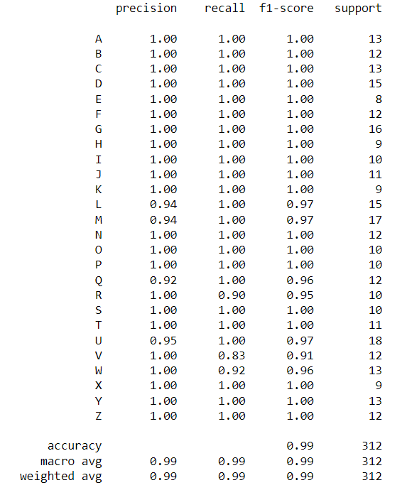
Report

Slide 20
Conclusion and future works
From the above system we can recognize the American Sign Language(ASL) and detect the gestures.
The system can be used in different areas like human computer interface etc.
The future works will be to improve the accuracy of the algorithm.
The future work is to generate words from the system.

Slide 21
references
A. A. Abdulhussein and F. A. Raheem, “Hand gesture recognition of static letters American sign language (ASL) using deep learning,” Engineering and Technology Journal, Vol. 38, No. 06, pp. 926-937, 2020.
Teak-Wei Chong and Boon-Giin Lee, American Sign Language Recognition Using Leap Motion Controller with Machine Learning Approach, Department of Electronics Engineering, Keimyung University, Daegu 42601, Korea, October 2018.
Matteo Rinalduzzi, Alessio De Angelis, Francesco Santoni, Emanuele Buchicchio, Antonio Moschitta, Paolo Carbone, Paolo Bellitti, Mauro Serpelloni, Gesture Recognition of Sign Language Alphabet Using a Magnetic Positioning System, June 2021.
Rajesh George Rajan, Dr.M.Judith Leo, American Sign Language Alphabets Recognition using Hand Crafted and Deep Learning Features IEEE Xplore Part Number:CFP20F70-ART published on 2020.
Sourav Bhowmick, Sushant Kumar and Anurag Kumar, Hand Gesture Recognition of English Alphabets using Artificial Neural Network, published on 2015.
Ross E. Mitchell, Gallaudet Research Institute, Draft manuscript accepted for publication in Sign Language Studies, Volume 6, Number 3, 2006.
Onamon Pinsanoh, Yuttana Kitjaidure, Ariya Thongtawee. A Novel Feature Extraction for American Sign Language Recognition Using Webcam. Published in 2018.
Chinmaya R. Naguri, Razvan C. Bunescu.Recognition of Dynamic Hand Gestures from 3D Motion Data using LSTM and CNN architectures. Published in 2017.

Slide 22
References
9. Kshitij Meena, Manish Kumar, Mohit Jangra Controlling Mouse Motions Using Eye Tracking Using Computer Vision, Published in 2020.
Kai Li, Qieshi Zhang, Jun Cheng, Jianming Liu .Hand Gesture Tracking and Recognition based Human-Computer Interaction System and Its Applications published on 2018.
Subhangi Adhikary, Anjan Kumar Talukdar, Kandarpa Kumar Sarma A Vision-based System for Recognition of Words used in Indian Sign Language Using MediaPipe . Published on 2021.
Vaishnav Chunduru; Mrinalkanti Roy; Dasari Romit N. S; Rajeevlochana G. Chittawadigi. Hand Tracking in 3D Space using MediaPipe and PnP Method for Intuitive Control of Virtual Globe published on 2021.
Srseehari Sreenath; D. Ivan Daniels; Apparaju S. D. Ganesh; Yashaswi S. Kuruganti; Rajeevlochana G. Chittawadigi.Monocular Tracking of Human Hand on a Smart Phone Camera using MediaPipe and its Application in Robotics. Published on 2021.
Arpana Mahajan; Jhanvi Patel; Mittal Parmar; Gomes Luis Abrantes Joao; Kishori Shekokar; Sheshang Degadwala.3-Layer LSTM Model for Detection of Epileptic Seizures Published in 2020.
Md Rashedul Islam; Ummey Kulsum Mitu; Rasel Ahmed Bhuiyan; Jungpil Shin. Hand Gesture Feature Extraction Using Deep Convolutional Neural Network for Recognizing American Sign Language. Published in 2018.
Xingyao Zhang; Haojun Xia; Donglin Zhuang; Hao Sun; Xin Fu; Michael B. Taylor; Shuaiwen Leon Song . η-LSTM: Co-Designing Highly-Efficient Large LSTM Training via Exploiting Memory-Saving and Architectural Design Opportunities. Published in 2021.
Diederik P. Kingma, Jimmy Ba. Adam: A Method for Stochastic Optimization. Published as a conference paper at the 3rd International Conference for Learning Representations, San Diego, 2015.

Slide 23
References
9. Kshitij Meena, Manish Kumar, Mohit Jangra Controlling Mouse Motions Using Eye Tracking Using Computer Vision, Published in 2020.
Kai Li, Qieshi Zhang, Jun Cheng, Jianming Liu .Hand Gesture Tracking and Recognition based Human-Computer Interaction System and Its Applications published on 2018.
Subhangi Adhikary, Anjan Kumar Talukdar, Kandarpa Kumar Sarma A Vision-based System for Recognition of Words used in Indian Sign Language Using MediaPipe . Published on 2021.
Vaishnav Chunduru; Mrinalkanti Roy; Dasari Romit N. S; Rajeevlochana G. Chittawadigi. Hand Tracking in 3D Space using MediaPipe and PnP Method for Intuitive Control of Virtual Globe published on 2021.
Srseehari Sreenath; D. Ivan Daniels; Apparaju S. D. Ganesh; Yashaswi S. Kuruganti; Rajeevlochana G. Chittawadigi.Monocular Tracking of Human Hand on a Smart Phone Camera using MediaPipe and its Application in Robotics. Published on 2021.
Arpana Mahajan; Jhanvi Patel; Mittal Parmar; Gomes Luis Abrantes Joao; Kishori Shekokar; Sheshang Degadwala.3-Layer LSTM Model for Detection of Epileptic Seizures Published in 2020.
Md Rashedul Islam; Ummey Kulsum Mitu; Rasel Ahmed Bhuiyan; Jungpil Shin. Hand Gesture Feature Extraction Using Deep Convolutional Neural Network for Recognizing American Sign Language. Published in 2018.
Xingyao Zhang; Haojun Xia; Donglin Zhuang; Hao Sun; Xin Fu; Michael B. Taylor; Shuaiwen Leon Song . η-LSTM: Co-Designing Highly-Efficient Large LSTM Training via Exploiting Memory-Saving and Architectural Design Opportunities. Published in 2021.
Diederik P. Kingma, Jimmy Ba. Adam: A Method for Stochastic Optimization. Published as a conference paper at the 3rd International Conference for Learning Representations, San Diego, 2015.

Slide 24
References
Karabasi, M.; Bhatti, Z.; Shah, A. A model for real-time recognition and textual representation of malaysian sign language through image processing. In Proceedings of the 2013 International Conference on Advanced Computer Science Applications and Technologies, Kuching, Malaysia, 23–24 December 2013; pp. 195–200.
Van den Bergh, M.; Carton, D.; De Nijs, R.; Mitsou, N.; Landsiedel, C.; Kuehnlenz, K.; Wollherr, D.; Van Gool, L.; Buss, M. Real-time 3D hand gesture interaction with a robot for understanding directions from humans. In Proceedings of the 2011 Ro-Man, Atlanta, GA, USA, 31 July–3 August 2011.
Zhao, X.; Naguib, A.M.; Lee, S. Kinect based calling gesture recognition for taking order service of elderly care robot. In Proceedings of the The 23rd IEEE international symposium on robot and human interactive communication, Edinburgh, UK, 25–29 August 2014.
Desai, S.; Desai, A. Human Computer Interaction through hand gestures for home automation using Microsoft Kinect. In Proceedings of the International Conference on Communication and Networks, Xi’an, China, 10–12 October 2017.
Wang, R.Y.; Popovi´c, J. Real-time hand-tracking with a color glove. ACM Trans. Graph. 2009.
Kaur, H.; Rani, J. A review: Study of various techniques of Hand gesture recognition. In Proceedings of the 2016 IEEE 1st International Conference on Power Electronics, Intelligent Control and Energy Systems (ICPEICES), Delhi, India, 4–6 July 2016.
Rajesh, R.J.; Nagarjunan, D.; Arunachalam, R.M.; Aarthi, R. Distance Transform Based Hand Gestures Recognition for PowerPoint Presentation Navigation.
Suriya, R.; Vijayachamundeeswari, V. A survey on hand gesture recognition for simple mouse control. In Proceedings of the International Conference on Information Communication and Embedded Systems (ICICES2014), Chennai, India, 27–28 February 2014.
A. Sahayadhas, K. Sundaraj, and M. Murugappan. Detecting driver drowsiness based on sensors: A review. MDPI open access: sensors, 2012.
A Review on Human-Computer Interaction and Intelligent Robots, Fuji Ren*,†,‡ and Yanwei Bao*, International Journal of Information Technology & Decision Making Vol. 19, No. 1Published 17 February 2020.

Slide 25
References
Sepp Hochreiter ,Fakultat fur Informatik, Technische Universitat Munchen, 80290 Munchen, Germany. LONG SHORT-TERM MEMORY, Neural Computation 9(8):1735-1780, 1997.
Deep Learning in Neural Networks: An Overview.Jurgen Schmidhuber,The Swiss AI Lab IDSIA,Istituto Dalle Molle di Studi sull’Intelligenza Artificiale,University of Lugano & SUPSI,Galleria 2, 6928 Manno-Lugano,Switzerland,8 October 2014.
Deep Learning using Rectified Linear Units (ReLU). Abien Fred M. Agarap . arXiv:1803.08375v2 [cs.NE] 7 Feb 2019.
Balaji, A. Jayanth, D. S. Harish Ram, and Binoy B. Nair. "A deep learning approach to electric energy consumption modeling." Journal of Intelligent & Fuzzy Systems 36, no. 5 (2019): 4049-4055.
Kumar, S., M. Anand Kumar, and K. P. Soman. "Deep learning based part-of-speech tagging for Malayalam Twitter data (Special issue: deep learning techniques for natural language processing)." Journal of Intelligent Systems 28, no. 3 (2019): 423-435.
Premjith, B., K. P. Soman, and M. Anand Kumar. "A deep learning approach for Malayalam morphological analysis at character level." Procedia computer science 132 (2018): 47-54.
Aravinda Reddy, D., M. Anand Kumar, and K. P. Soman. "LSTM based paraphrase identification using combined word embedding features." In Soft computing and signal processing, pp. 385-394. Springer, Singapore, 2019.4

Slide 26


